Slide 1
Instructional best practices slides for professional learning
Part 1: Safeguarding academic integrity
© 2023 Turnitin LLC. All rights reserved.

Slide 2
Guidance
Facilitators: How to use this series of presentations
The resources in this slide presentation are intended for the use of facilitators within institutions to use with other educators to provide guidance for best instructional practices in using Feedback Studio.
Please note that these resources are to be presented after an introductory product feature training. The focus is on instructional best practices, not “how to”
or “set up” activities.
Each resource is appropriate for educators in both secondary and
higher education settings, and each can and should be adapted to
meet the needs of educators with varying levels of experience with
Feedback Studio.
Each presentation can be utilized as a standalone asset or used
together, depending on the needs of educators within the
institution/district.
Use this slide presentation to introduce Feedback Studio. Edit as you see fit, but please first make a copy of these slides by:
Go to “File” tab
Click on “Make a copy”
Select “Entire presentation”
Notes:
Presenter notes: For more detailed information on how to plan this session and activities, please access the Facilitator Guide: Part 1.

Slide 3
Which of the following statements are true about Feedback Studio?
Feedback Studio is only useful for checking for similarity.
Scoring essays is the only use case with Feedback Studio.
Feedback Studio can only be used for English or writing teachers.
Feedback can be delivered in Feedback Studio in multiple ways.
Feedback cycles can be streamlined with the use of Feedback Studio.
Feedback Studio can bring uniformity to feedback within my department/institution.
Notes:
Presenter notes: Use as an anticipatory set/introductory activity so that the presenter can accurately gauge participants’ understanding of what Feedback Studio can do prior to the presentation. Presenter might also move this activity to another point in the session, depending on delivery and structure of session.
For further suggestions, please access the Facilitator guide: Part 1

Slide 4
Which of the following statements are true about Feedback Studio?
1. Feedback Studio is only useful for checking for similarity.
2. Scoring essays is the only use case with Feedback Studio.
3. Feedback Studio can only be used for English or writing teachers.
4. Feedback can be delivered in Feedback Studio in multiple ways.
5. Feedback cycles can be streamlined with the use of Feedback Studio.
6. Feedback Studio can bring uniformity to feedback within my department/institution.
Notes:
Presenter notes: Use the mouse to reveal each statement – the true statements will be in blue. Be sure to discuss each statement. For suggested focus points, please access the Facilitator guide: Part 1

Slide 5
Objectives
Educators will apply their understanding of Feedback Studio best practices to
safeguard academic integrity;
drive better student outcomes by personalizing student feedback;
empower students to understand and address writing issues before final submission; and
increase their own efficiency
Notes:
Presenter notes: The objectives listed here are fairly broad and definitely will require check-ins after this session to make sure that people have all the information and help they need to move forward to best meet the institution’s goals for using Feedback Studio. Part 1 of the series focuses on the highlighted first objective. The objectives that remain are developed in the other slide decks of the series, but they are all included on this slide so that it is clear what benefits can come from the inclusion of Feedback Studio as a part of the institution’s professional learning on how to commit to a culture of academic integrity and promoting best practices in providing feedback.
This slide is deliberately placed after the warm-up activity as discussing the objectives prior to those statements will serve to give responses and not give the presenter an accurate understanding of what the participants know and understand already.

Slide 6
Why Feedback Studio?
#1 – Feedback and grading represent some of the more difficult tasks that educators face–and often dread!
Feedback Studio extends student achievement and agency by
providing tools such as the Similarity Report to aid educators in making decisions about perceived plagiarism in student work,
providing tools such as the AI writing indicator* to aid educators in making decisions about potential AI misuse,
using tools such as Draft Coach to empower students to edit prior to submissions, and
providing feedback tools in a variety of formats and options to streamline the feedback process
Notes:
Presenter notes: Transition from the objectives to providing a “why” for using Feedback Studio to achieve the objective.
* If your institution is not licensed for the AI writing indicator, B should be deleted before presenting.
Suggested talking points can be found by accessing the Facilitator Guide: Part 1

Slide 7
Where in the writing process would a tool like Feedback Studio be most effective?
[add participant responses in this space]
Turnitin Originality rises above basic text similarity checking to provide every institution a new standard in academic integrity.
Notes:
Presenter notes: This is a good place to stress that the feedback cycle using a tool like Feedback Studio mimics the writing process. The Facilitator guide: Part 1 can provide further guidance.

Slide 8
Safeguarding academic integrity
Notes:
Presenter notes: This may be a good time to discuss what this means, both in general and in terms of the school or institution. In order to safeguard academic integrity, a commonly held definition of what that means should be in place. Consider what this might currently look like and what expectations are moving forward: What would you expect to see/hear educators/students doing/saying? What policies would be in effect?

Slide 9
What is academic integrity?
In order to safeguard it, first establish what it is!
Be explicit and proactive in presenting the academic integrity policy to students at the beginning of the school year:
Define academic integrity: What values does it represent within classrooms? Within the institution overall?
Reference the academic integrity policy or honor code in place within the institution.
Reference the school/institution’s honor code. Is there a need to create one for individual classrooms?
Communicate #s 1-3 with students, parents, and all other stakeholders and how students are supported during their implementation.
Notes:
Presenter notes: Specifically discuss each of the above notes. Further guidance can be found in the Facilitator guide: Part 1.

Slide 10
What is the relationship between similarity and plagiarism?
How does the educator make this clear?
The Similarity Score represents the percentage of a student’s writing that is similar to something found on the internet, in our databases, or in someone else’s paper. Similarity does not mean that this work is plagiarized. Consider a student’s use of quotations, citations, and bibliographic material when reviewing the score.
Each indicates an area of academic weakness in students, intentional or unintentional.
Here’s where the educator’s judgement is essential: what are the student’s intentions?
The answer will lead the educator to an opportunity for instruction or, if deemed necessary, a referral to their institution’s academic integrity officer.
Plagiarism is often–but not always– intentional and always has its origins in someone else’s work. It can result from copying others’ work directly, incorrect citations or failure to cite work at all, or having someone else complete the work.
Notes:
Presenter notes: Be intentional about ensuring that anyone attending this presentation understands the difference between these two words. A thorough understanding is necessary for educators to know how to proceed with the Similarity Score and how to communicate this with students. For more references, access the Facilitator guide: Part 1.

Slide 11
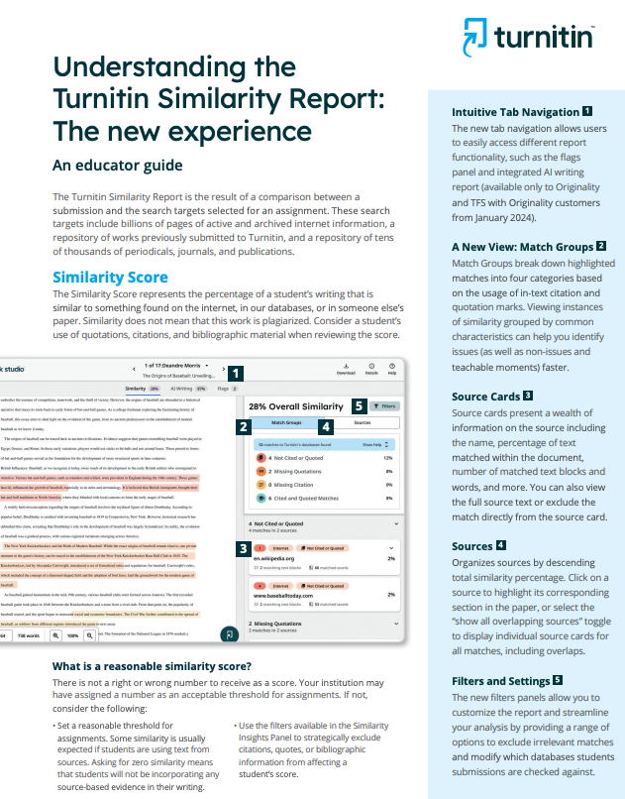
The Similarity Score
Each Similarity Report generates a similarity score which is the percentage of matching or similar text that has been uncovered. The Similarity Score is not a determination of plagiarism.
There is no right or wrong number to receive as a score. However, certain factors can dictate whether to expect more or less similarity from students’ work.
Notes:
Presenter notes:
Be sure to emphasize the bolded parts of the bulleted lists as these are key understandings regarding the Similarity Score.
The screenshot comes from the Educator Guide mentioned on the previous slide.
More resources to deepen participants’ understanding can be accessed in the Facilitator guide: Part 1.

Slide 12
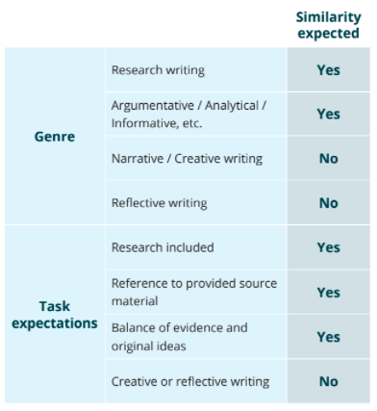
Tips for analyzing the Similarity Score:
Use the following tips when analyzing the similarity score:
Consider the genre and task expectations of the assignment
Consider the length of the assignment
Consider the skill level of students, especially regarding quoting, paraphrasing, and summarizing
Focus on score ranges rather than a single cutoff score
If scores are high provide formative opportunities for student revision
Notes:
Presenter notes:
Share the guidance on different reasons why a similarity score may be higher or lower using the Turnitin Help Guides.
Be sure to discuss the chart on this slide, especially to emphasize when it refers to genre, task expectations, and student skill level as each of these can influence the Similarity Score.

Slide 13
Use the Similarity Score formatively
Provide instructional supports for students so that they write with integrity intentionally.
Use Feedback Studio to submit multiple drafts
Access the Similarity Score – make sure that all stakeholders understand that this score does not necessarily indicate plagiarism
This number indicates how much of the paper matched an outside source.
Notes:
Presenter notes: Depending on the skill level of the participants, share the Help Guide or the Educator’s Guide for help in understanding the Similarity Score. Further suggestions as to available resources can be located in the Facilitator guide: Part 1.

Slide 14
Interpreting the Similarity Score with students
Do
Don’t
Set clear expectations regarding academic integrity
Help students understand the relationship and differences between similarity and plagiarism
Use the Similarity Score formatively
Ensure that students understand the Similarity Score and what it means about their writing
Use the Similarity Score as a “gotcha” or punitive measure
Conflate similarity and plagiarism
Use the Similarity Score exclusively as a summative measure
Implement the use of the Similarity Score without ensuring that students understand what it means and how they can use it to improve their writing
Notes:
Presenter notes: This slide summarizes some key points in how to use the Similarity Score with students. Make sure that participants have a thorough understanding of how to interpret the Similarity Score correctly and how to present it to students. Further guidance and resources can be found in the Facilitator guide: Part 1.

Slide 15
What is plagiarism?
Don’t leave room for interpretation!
Be intentional and specific before making assignments:
Define plagiarism in all its forms: Definition and Plagiarism Spectrum 2.0.
Link academic integrity to students’ sense of values, rather than solely on their role as a student.
Acknowledge that plagiarism can be intentional or unintentional.
Make room for student voice, values and responsibility as part of the process.
Be prepared to support students in learning how to avoid situations which may undermine the honor code and academic integrity.
Notes:
Presenter notes: Each of these concepts will be discussed in more detail in the slides that follow. Appropriate resources will be linked. Further guidance and resources can be found in the Facilitator guide: Part 1.

Slide 16
What is plagiarism?
Be intentional and specific before making assignments:
Define plagiarism in all its forms:
According to the Merriam-Webster online dictionary, to "plagiarize" means:
to steal and pass off (the ideas or words of another) as one's own
to use (another's production) without crediting the source
to commit literary theft
to present as new and original an idea or product derived from an existing source
“Plagiarize.” Merriam-Webster.com. Merriam-Webster. Accessed May 20, 2020. https://www.merriam-webster.com/dictionary/plagiarize.
Notes:
Presenter notes: Discuss the definition with participants and stress the importance of establishing a culture of academic integrity in their institution as a foundation for their honor code/academic integrity policy. Further guidance and resources can be found in the Facilitator guide: Part 1.

Slide 17
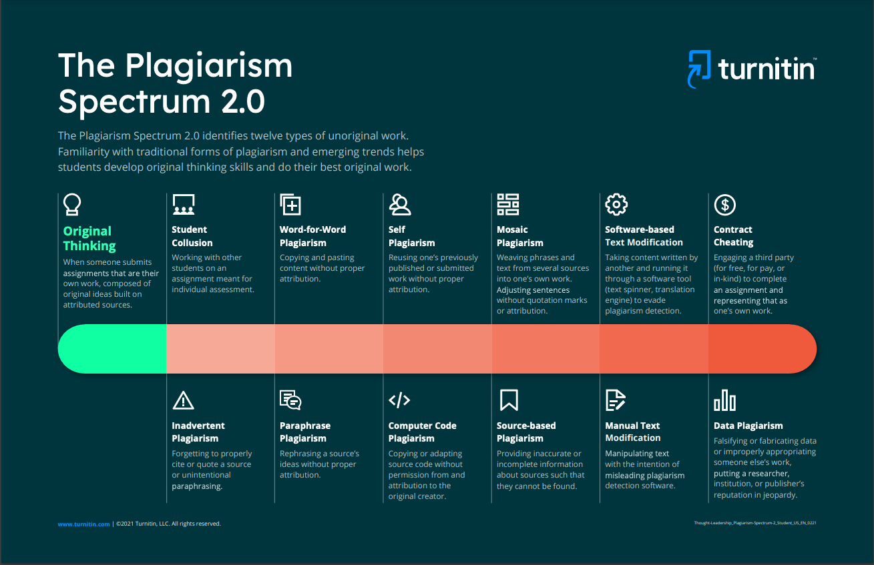
What is plagiarism?
Be intentional and specific before making assignments:
Define plagiarism in all its forms: Students may not realize that they are plagiarizing when using some of these methods.
Notes:
Presenter notes: Consider allowing time for one of the suggested activities in the accompanying Facilitator guide: Part 1 or feel free to adapt them to suit participant needs and institution goals.

Slide 18
What is plagiarism?
Be intentional and specific before making assignments:
2. Link academic integrity to students’ sense of values, rather than solely on their role as a student.
Go beyond discussing what plagiarism is to creating an honor code together.
Recognize that these values are not “one and done” at the beginning of the school year or semester. They must be in the forefront of all assignments and revisited throughout the course.
Notes:
Presenter notes: Take time to discuss that there are consequences for plagiarizing in k12 and university levels, including in the professional world, but here is a place to foster discussion with educators on how to place the value of academic integrity for students personally, rather than simply to avoid consequences. Further guidance and resources can be found in the Facilitator guide: Part 1.

Slide 19
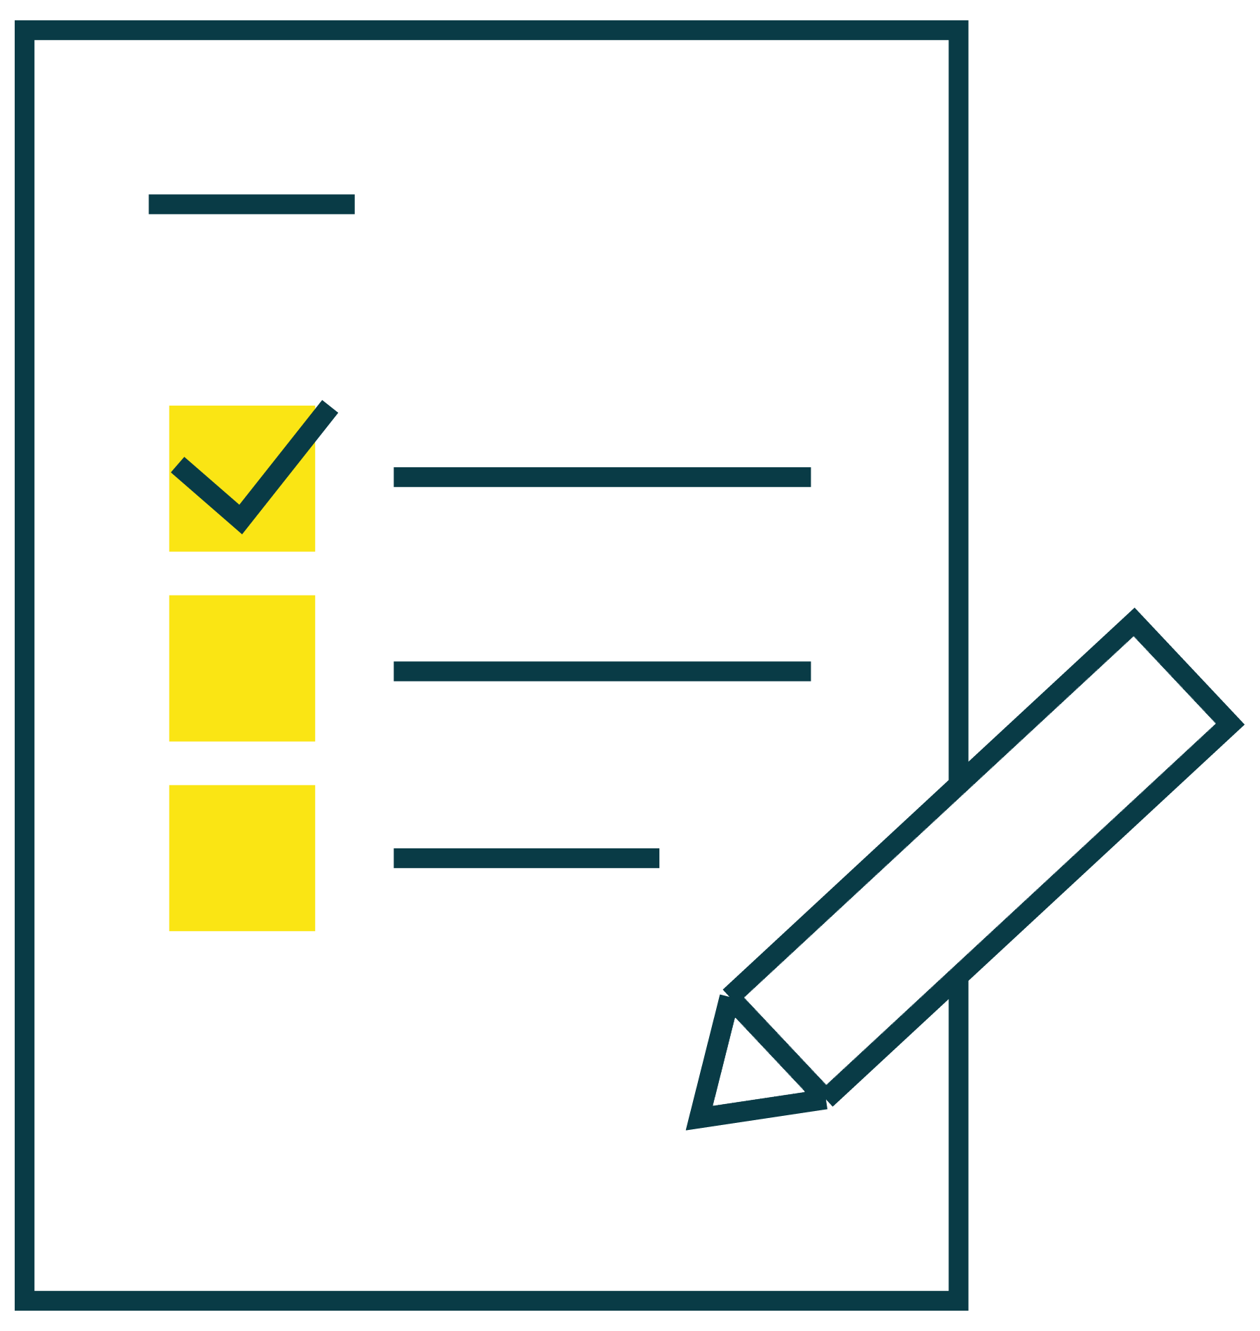
How can we deepen student understanding of academic integrity?
Provide instructional supports for students so that they write with integrity intentionally.
Many instances of unintentional plagiarism are the result of poor understanding of skills such as paraphrasing or citing sources.
As the saying goes, the best defense is a good offense, so teach students how to
research effectively – find credible sources
paraphrase efficiently when a direct quote isn’t needed
cite sources using a style guide/manual
Notes:
Presenter notes: Allow time if possible for participants to review resources available for use with students resources to address the above issues. Further guidance and resources can be found in the Facilitator guide: Part 1.

Slide 20
How well do you know similarity?
Pop quiz!
What is similarity? How is it similar to plagiarism? How is it different?
What is the difference between intentional and unintentional plagiarism?
How can/should educators respond differently to intentional and unintentional plagiarism?
How creative are your students when they plagiarize? Are you able to identify more than just a simple “copy and paste?”
How can establishing an honor code or academic integrity policy help students exhibit academic integrity?
How does the Similarity Report help educators and students to improve writing?
Notes:
Presenter notes: Although various activities have been included to help participants understand the various aspects of plagiarism and best practices for using the Similarity report, it is important to understand how ready educators are to present and discuss with students and implement usage. We suggest accessing the assessment activities found in the accompanying Facilitator guide: Part 1 to address the objective: safeguarding academic integrity. Use the Evaluation Framework and/or the Evaluation Framework with text examples to complete the activities.

Slide 21
Closing discussion:
Plagiarism? Why or why not?
An educator is disappointed that Turnitin didn't catch a "plagiarized" sentence from a journal that is in our database. When looking at the student work, it was obvious that the student did take a sentence from the journal and reworded it a fair amount while clearly keeping some of the key words and phrases from the original. However, the student did provide an inline citation, yet the educator was calling it plagiarism.
When questioned, they answered "The APA 7th ed. Manual actually references Turnitin as a plagiarism-checking software that can be used to identify cases of plagiarism where “passages of specified lengths match, or a few words have been changed but content is largely the same. To avoid plagiarism, students are expected to paraphrase and cite their sources, but not copy passages or sentences directly, with or without a citation."
Notes:
Presenter notes: In order to ascertain whether educators have a thorough understanding of the differences between plagiarism and similarity, take time to discuss this scenario thoroughly. Points to consider in your discussion can be found in the accompanying Facilitator guide: Part 1.

Slide 22
Q & A
Notes:
Presenter notes: This may be a good time to discuss what this means, both in general and in terms of the school or institution. In order to safeguard academic integrity, a commonly held definition of what that means should be in place. Consider what this might currently look like and what expectations are moving forward: What would you expect to see/hear educators/students doing/saying? What policies would be in effect?

Slide 23
Useful links
Educator resources
Lesson resources:
Disrupting Plagiarism Instructional Resource Pack
Plagiarism lesson presentation
Research strategies - Lesson presentation
Research planning worksheet
Understanding the Similarity Report: A student guide
Visual resources
Plagiarism Spectrum 2.0 infographic
Guide to paraphrasing video
Understanding text similarity for students video
AI writing resources
Getting started with AI writing at Turnitin - for administrators or for instructors
Comparing Turnitin’s Similarity Score and AI writing indicator
Educator guides:
Building and maintaining a classroom honor code
Disrupting Plagiarism educator guide
Paraphrasing educator guide
Interpreting the Similarity Score help guide
Understanding the Similarity Score
Setting Reasonable Expectations
Plagiarism Spectrum resources
Facilitator’s guide: Part 1
Notes:
Presenter notes: Most of the links listed on this slide have been provided throughout the slide presentation, but they are listed in one place for ease of reference. Consider copying this slide and distributing it to educators if you’re not planning on sharing the entire slide deck.

